Slide 1
ZNAKY RENESANCE
obrat od Boha k člověku
návrat k antice
vzestup vzdělanosti
antropocentrismus
humanismus
počátek v Itálii (14. - 16.století)
zámořské objevy, rozvoj vědy, umění

Slide 2
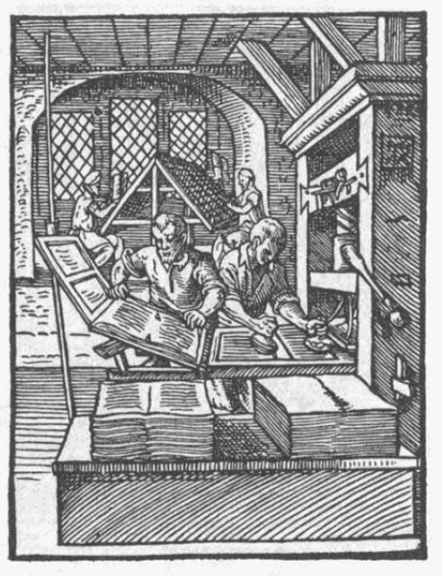
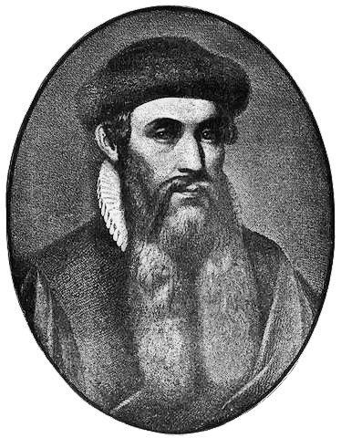
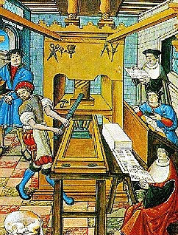
Knihtisk- 1450 – Johannes Gutenberg
http://upload.wikimedia.org/wikipedia/commons/3/33/Gutenberg.jpg
http://upload.wikimedia.org/wikipedia/commons/a/af/Buchdruck-15-jahrhundert_1.jpg
http://upload.wikimedia.org/wikipedia/commons/a/a0/Buchdrucker-1568.png

Slide 3
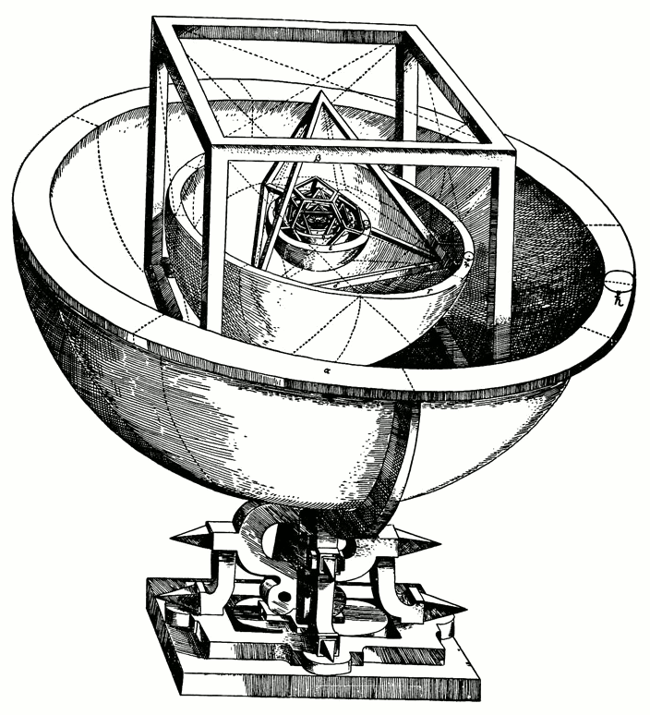
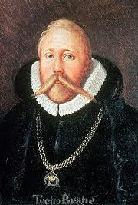
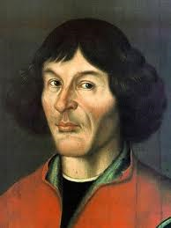
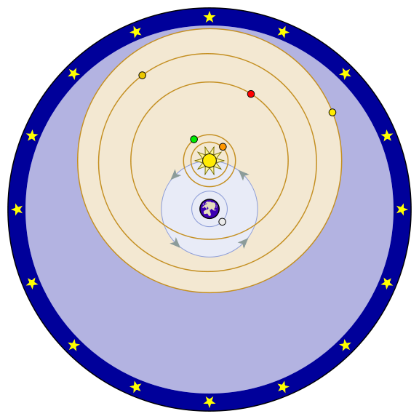
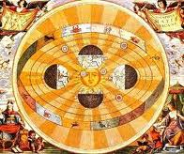

Mikuláš Koperník, Jan Kepler, Tycho de Brahe
http://upload.wikimedia.org/wikipedia/commons/2/2b/Tycho_Brahe.JPG
http://upload.wikimedia.org/wikipedia/commons/f/f2/Nikolaus_Kopernikus.jpg
Kolem Země obíhá Slunce a Měsíc a ostatní planety obíhají kolem Slunce
http://upload.wikimedia.org/wikipedia/commons/1/19/Kepler-solar-system-1.png
heliocentrismus
Keplerův model sluneční soustavy
http://upload.wikimedia.org/wikipedia/commons/thumb/d/d4/Johannes_Kepler_1610.jpg/436px-Johannes_Kepler_1610.jpg
http://upload.wikimedia.org/wikipedia/commons/thumb/a/a6/Tychonian_system.svg/576px-Tychonian_system.svg.png
http://upload.wikimedia.org/wikipedia/commons/5/57/Heliocentric.jpg

Slide 4
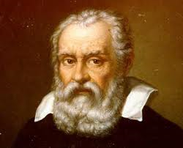
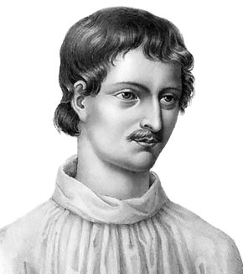
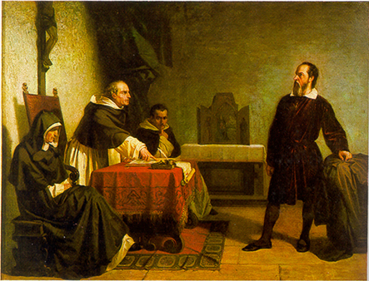
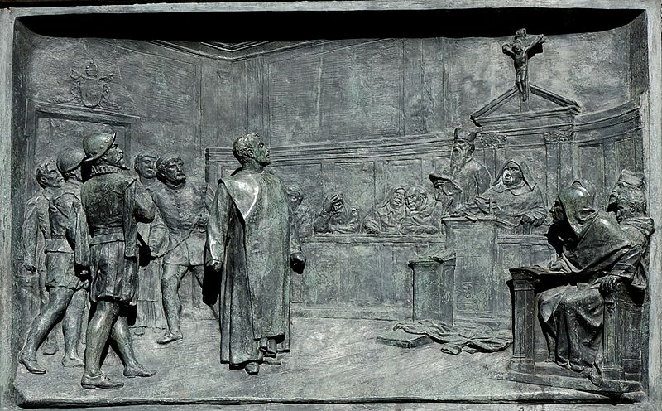
Galileo Galilei, Giordano Bruno
Vesmír je nekonečný!
http://upload.wikimedia.org/wikipedia/commons/thumb/6/6e/Galileo_by_Passignano.jpg/482px-Galileo_by_Passignano.jpg
A přece se točí!
Inkviziční soud
http://upload.wikimedia.org/wikipedia/commons/1/15/Giordano_Bruno.jpg
http://upload.wikimedia.org/wikipedia/commons/b/ba/Relief_Bruno_Campo_dei_Fiori_n1.jpg
http://upload.wikimedia.org/wikipedia/commons/8/88/Galileo_facing_the_Roman_Inquisition.jpg

Slide 5
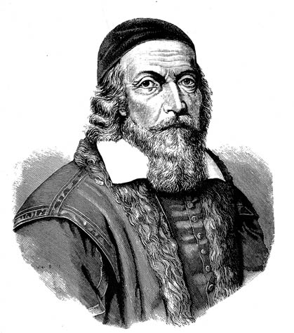
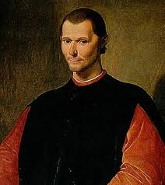
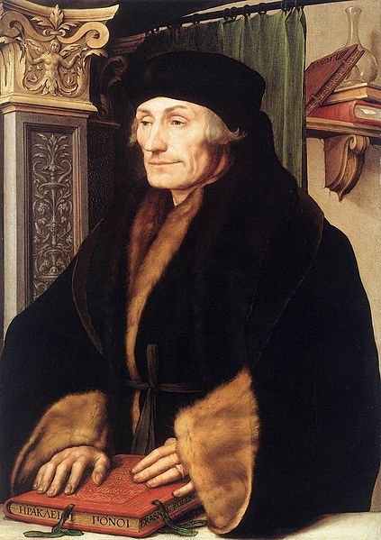
Niccolo Machiavelli, Erasmus Rotterdamský, Jan Ámos Komenský
http://upload.wikimedia.org/wikipedia/commons/2/27/Santi_di_Tito_-_Niccolo_Machiavelli%27s_portrait_headcrop.jpg
http://upload.wikimedia.org/wikipedia/commons/c/ce/Johan_amos_comenius_1592-1671.jpg
http://upload.wikimedia.org/wikipedia/commons/thumb/3/30/Holbein-erasmus.jpg/423px-Holbein-erasmus.jpg

Slide 6
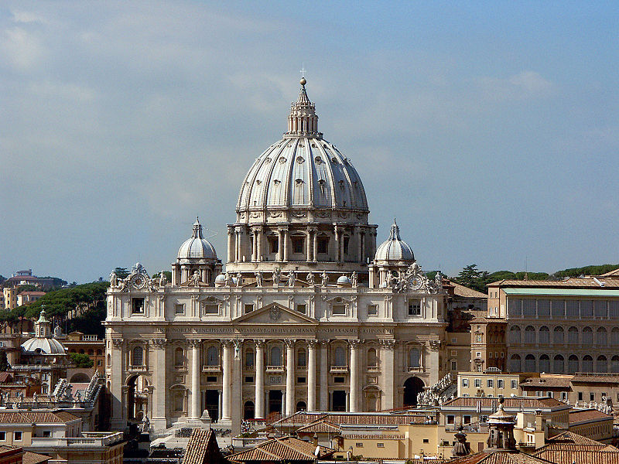
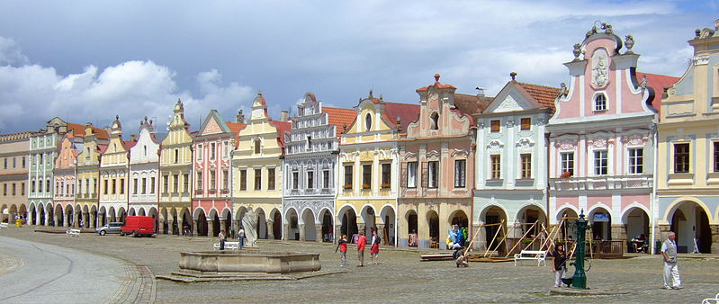
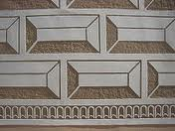
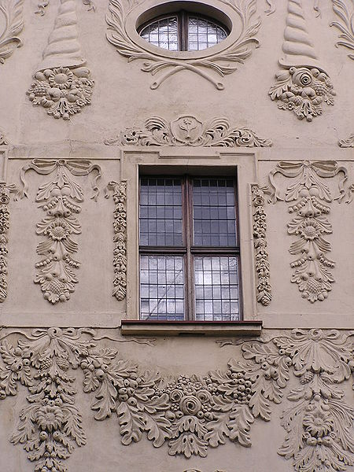
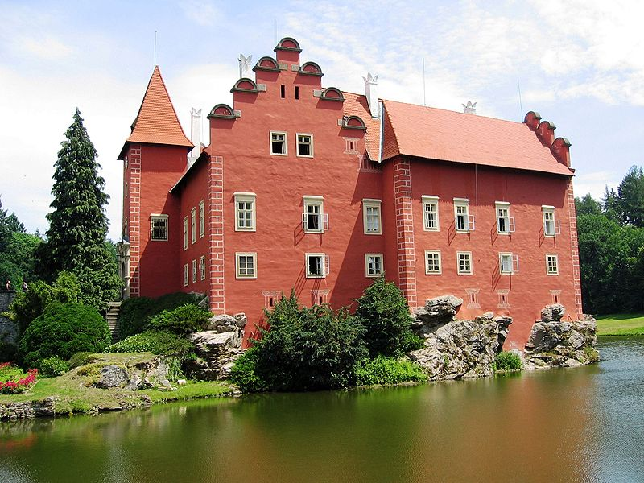
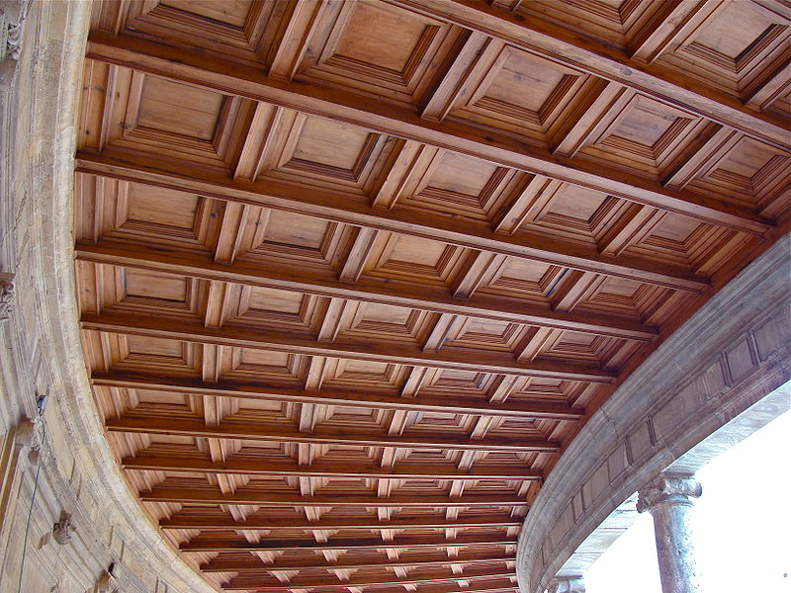
Znaky architektury
http://upload.wikimedia.org/wikipedia/commons/thumb/4/40/Telc109.jpg/799px-Telc109.jpg, CC BY_SA, autor: Hans Weingartz
http://upload.wikimedia.org/wikipedia/commons/thumb/1/15/Petersdom_von_Engelsburg_gesehen.jpg/800px-Petersdom_von_Engelsburg_gesehen.jpg
http://upload.wikimedia.org/wikipedia/commons/9/90/Breznice_PB_CZ_chateau_sgraffito_detail_605.jpg
http://upload.wikimedia.org/wikipedia/commons/thumb/0/01/Cervena_Lhota%2C_Czech_Republic.jpg/800px-Cervena_Lhota%2C_Czech_Republic.jpg, CC BY-SA, autor Zdeněk Svoboda
http://upload.wikimedia.org/wikipedia/commons/8/86/The_D%C4%85bski_Palace1.JPG
http://upload.wikimedia.org/wikipedia/commons/thumb/5/5f/PlafondCharles_Quint.JPG/800px-PlafondCharles_Quint.JPG, CC BY-SA, autor: jebulon
Notes:
Kopule (chrám sv. Petra v Římě), měšťanské domy (Telč), zámek (Červená Lhota), štukování, kazetový strop, sgrafito

Slide 7
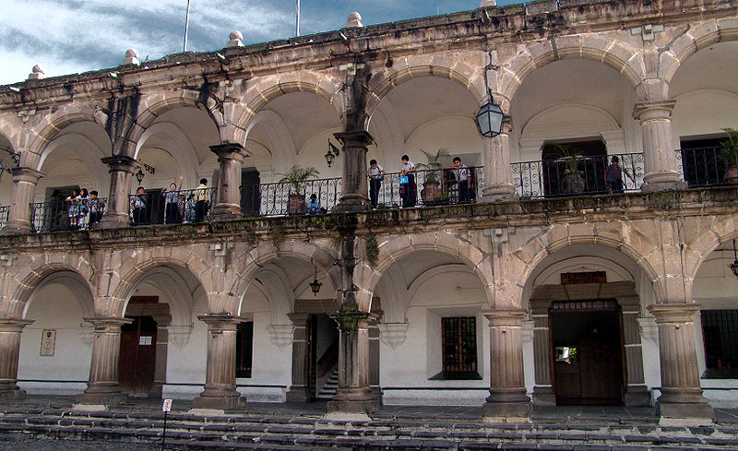
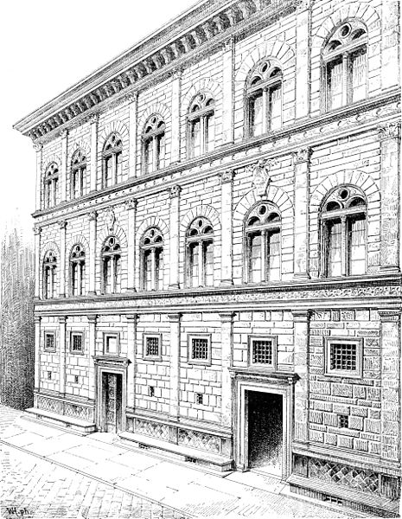
Další znaky
Arkády a pravoúhlá velká okna
horizontální stavby
světské stavby (zámek, měšťanské domy, paláce, kašny, radnice, jízdárny, letohrádky)
velká pravoúhlá okna
světlost
arkády
antické vzory
http://upload.wikimedia.org/wikipedia/commons/a/a2/GT056-Antigua_SchlKids.jpeg
Palác má v každém patře jiné antické sloupy
Přízemí – dórský, 1.patro – iónský, 2. patro - korintský
http://upload.wikimedia.org/wikipedia/commons/thumb/c/cc/Rucellai.jpg/465px-Rucellai.jpg

Slide 8
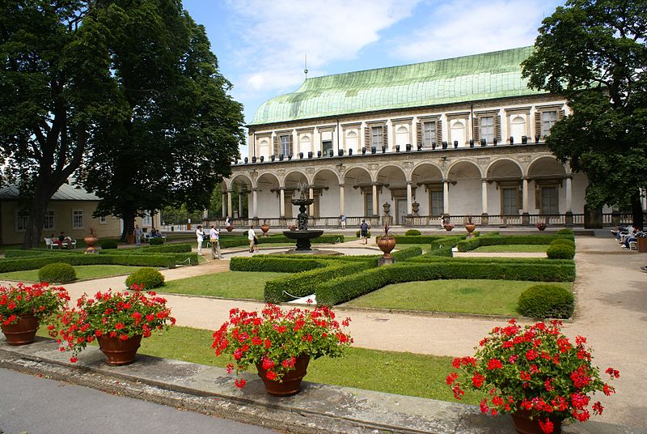
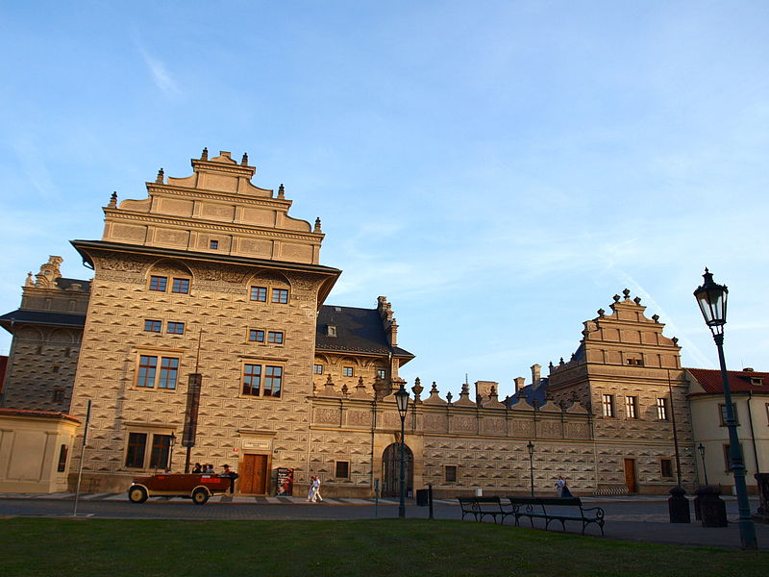
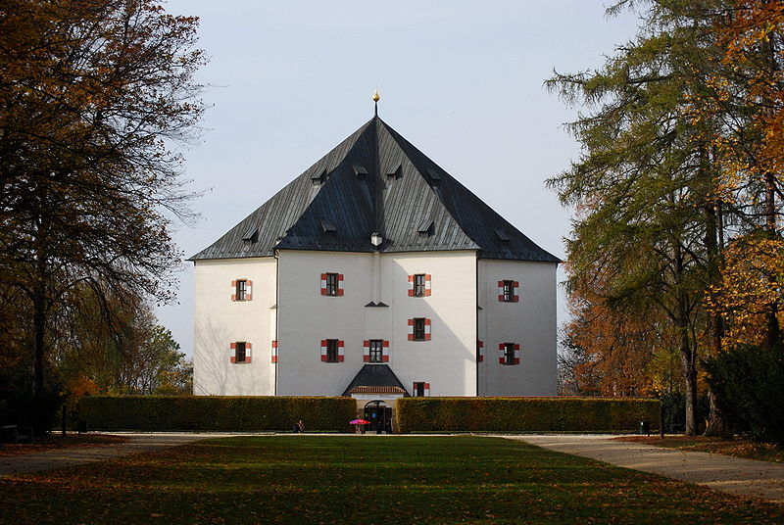
Stavby v českých zemích
http://upload.wikimedia.org/wikipedia/commons/thumb/2/2d/Pra%C5%BEsk%C3%BD_hrad%2C_Letohr%C3%A1dek_kr%C3%A1lovny_Anny_02.jpg/800px-Pra%C5%BEsk%C3%BD_hrad%2C_Letohr%C3%A1dek_kr%C3%A1lovny_Anny_02.jpg, CC BY-SA, autor: Karen Blaha
http://upload.wikimedia.org/wikipedia/commons/thumb/6/6a/Schwarzenbersk%C3%BD_pal%C3%A1c_1.JPG/200px-Schwarzenbersk%C3%BD_pal%C3%A1c_1.JPG,CC BY-SA, autor: VitVit
Letohrádek královny Anny
Schwarzenberský (Lobkovický) palác na Hradčanském náměstí
Letohrádek Hvězda
http://upload.wikimedia.org/wikipedia/commons/thumb/4/40/LetohradekHvezda2.jpg/800px-LetohradekHvezda2.jpg, CC BY-SA, autor: Adam Zivner

Slide 9
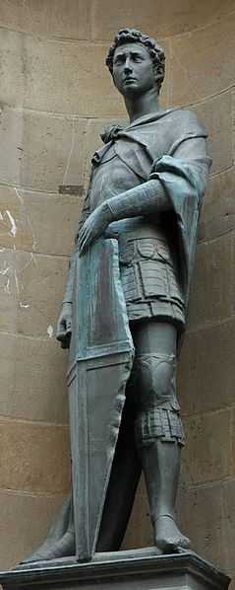
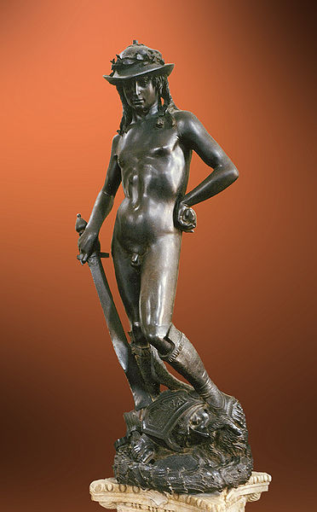
Donatello - florentský sochař - sochařské portréty
Socha sv. Jiří
http://upload.wikimedia.org/wikipedia/commons/thumb/f/f0/Donatello_-_David_-_Floren%C3%A7a.jpg/372px-Donatello_-_David_-_Floren%C3%A7a.jpg, CC BY-SA, autor: Patrick A.Rodgers
Bronzový David
http://upload.wikimedia.org/wikipedia/commons/thumb/a/af/St_George_Donatello_Orsanmichele_n1.jpg/239px-St_George_Donatello_Orsanmichele_n1.jpg

Slide 10
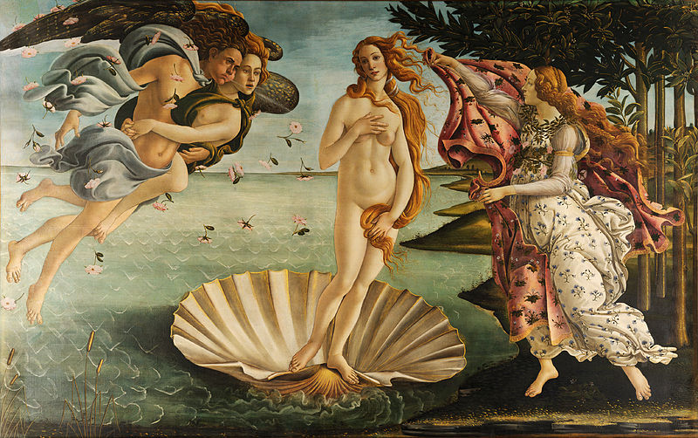
Sandro Boticelli
Zrození Venuše
http://upload.wikimedia.org/wikipedia/commons/thumb/0/0b/Sandro_Botticelli_-_La_nascita_di_Venere_-_Google_Art_Project_-_edited.jpg/800px-Sandro_Botticelli_-_La_nascita_di_Venere_-_Google_Art_Project_-_edited.jpg

Slide 11
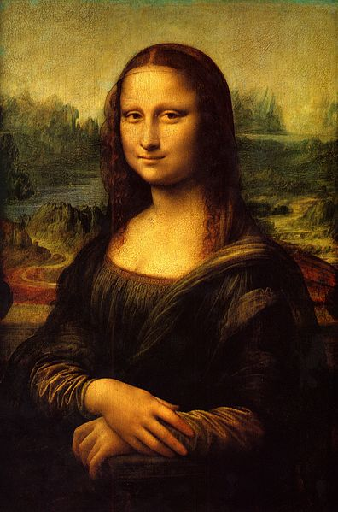
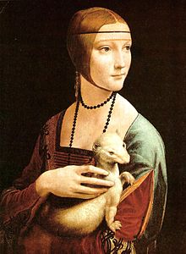
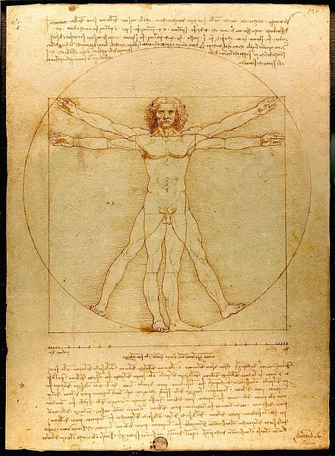
Leonardo da Vinci malíř, sochař, vynálezce, přírodovědec, architekt
http://upload.wikimedia.org/wikipedia/commons/thumb/6/6a/Mona_Lisa.jpg/396px-Mona_Lisa.jpg
http://upload.wikimedia.org/wikipedia/commons/thumb/5/57/Lady_with_an_Ermine.jpg/439px-Lady_with_an_Ermine.jpg
Mona Lisa
Dáma s hranostajem
http://upload.wikimedia.org/wikipedia/commons/thumb/2/22/Da_Vinci_Vitruve_Luc_Viatour.jpg/441px-Da_Vinci_Vitruve_Luc_Viatour.jpg

Slide 12
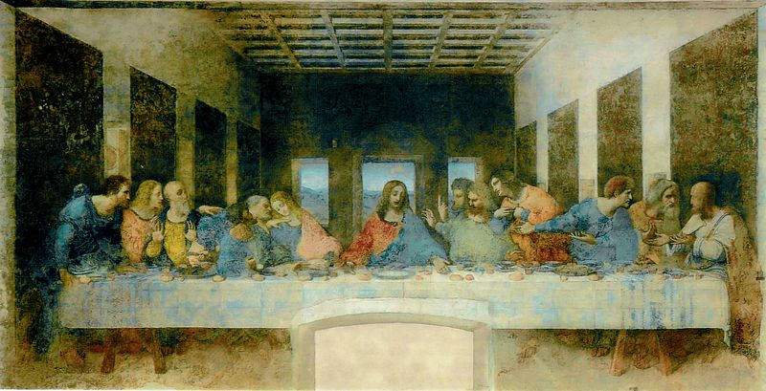
Poslední večeře páně
http://upload.wikimedia.org/wikipedia/commons/thumb/0/08/Leonardo_da_Vinci_%281452-1519%29_-_The_Last_Supper_%281495-1498%29.jpg/800px-Leonardo_da_Vinci_%281452-1519%29_-_The_Last_Supper_%281495-1498%29.jpg

Slide 13
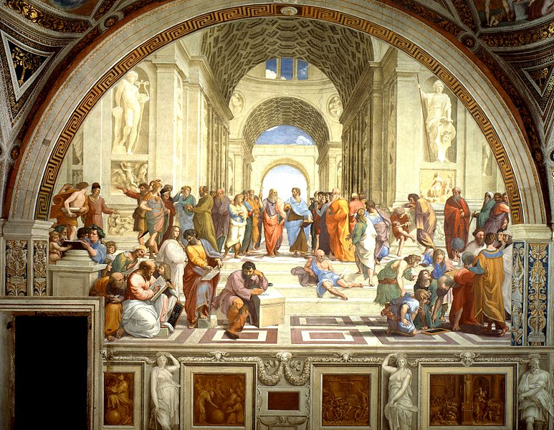
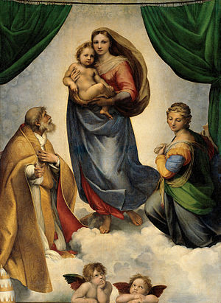
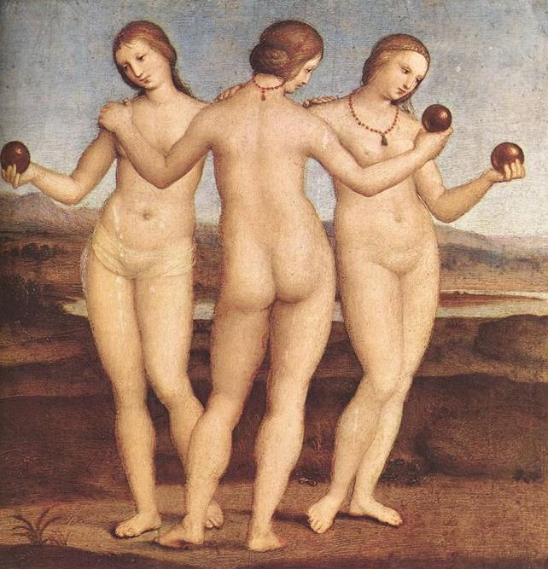
Raffael Santi malíř, sochař
Sixtinská madona
http://upload.wikimedia.org/wikipedia/commons/thumb/9/94/Sanzio_01.jpg/773px-Sanzio_01.jpg
Athénská škola
Tři grácie
http://upload.wikimedia.org/wikipedia/commons/thumb/9/94/Sanzio_00.jpg/444px-Sanzio_00.jpg
http://upload.wikimedia.org/wikipedia/commons/thumb/e/ea/Raffael_051.jpg/440px-Raffael_051.jpg

Slide 14
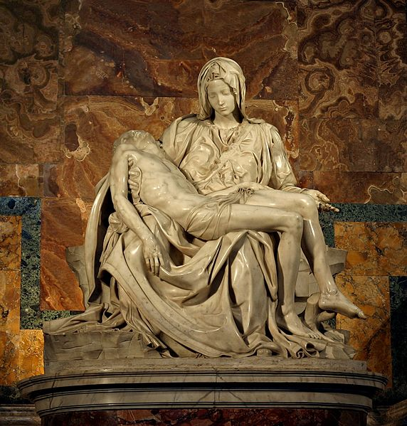
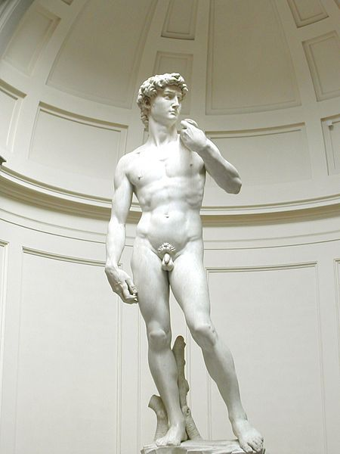
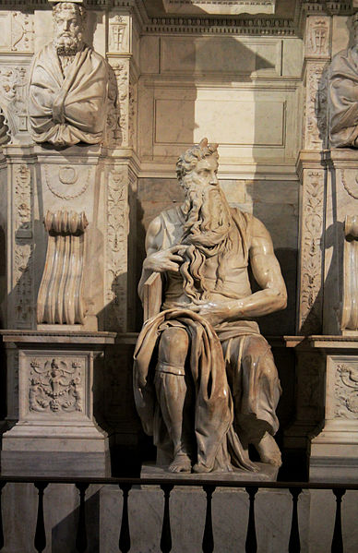
Michelangelo Buonarotti
sochař
malíř
architekt
http://upload.wikimedia.org/wikipedia/commons/thumb/1/1f/Michelangelo%27s_Pieta_5450_cropncleaned_edit.jpg/572px-Michelangelo%27s_Pieta_5450_cropncleaned_edit.jpg, CC BY-SA, autor: Stanislav Traykov
http://upload.wikimedia.org/wikipedia/commons/thumb/6/63/Michelangelos_David.jpg/450px-Michelangelos_David.jpg, CC BY-SA, autor: David Gaya
David
Pieta
Mojžíš
http://upload.wikimedia.org/wikipedia/commons/thumb/8/88/San_Pietro_in_Vincoli_Rome_2011_14.jpg/388px-San_Pietro_in_Vincoli_Rome_2011_14.jpg

Slide 15
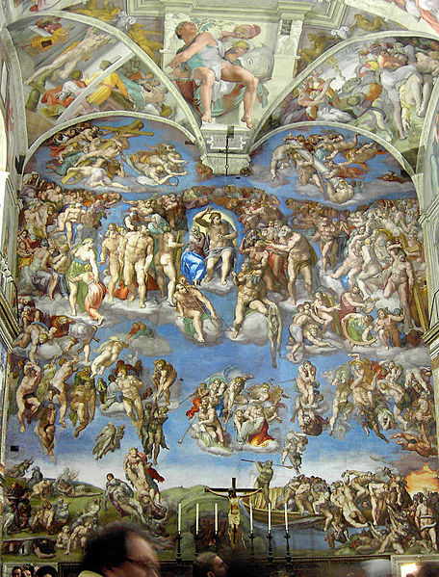
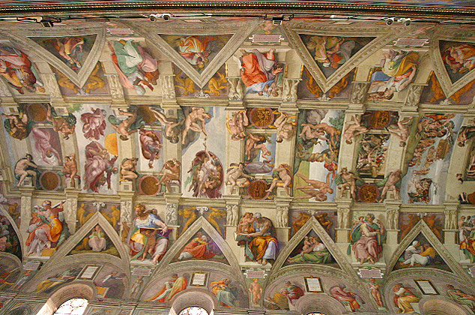
Sixtinská kaple (Poslední soud) Strop Sixtinské kaple
http://upload.wikimedia.org/wikipedia/commons/thumb/2/24/Rome_Sistine_Chapel_01.jpg/456px-Rome_Sistine_Chapel_01.jpg
http://upload.wikimedia.org/wikipedia/commons/d/db/Lightmatter_Sistine_Chapel_ceiling.jpg, CC BY-SA, autor: Aaron Logan

Slide 16
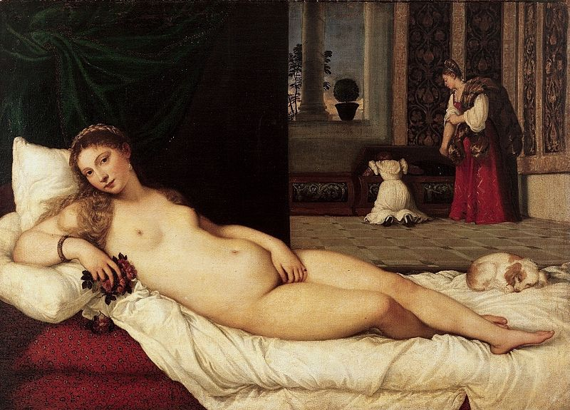
Tizian
Venuše Urbinská

Slide 17
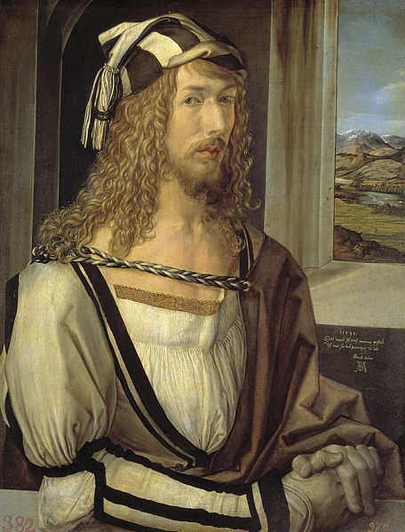
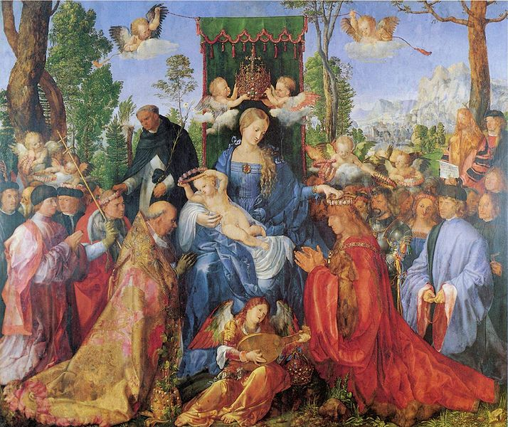
Manýrismus
Albrecht Dürer
Růžencová slavnost
http://upload.wikimedia.org/wikipedia/commons/thumb/8/88/Albrecht_D%C3%BCrer%2C_Selbstbildnis_mit_26_Jahren_%28Prado%2C_Madrid%29.jpg/456px-Albrecht_D%C3%BCrer%2C_Selbstbildnis_mit_26_Jahren_%28Prado%2C_Madrid%29.jpg
Vlastní podobizna
http://upload.wikimedia.org/wikipedia/commons/thumb/7/70/Albrecht_D%C3%BCrer_099.jpg/714px-Albrecht_D%C3%BCrer_099.jpg

Slide 18
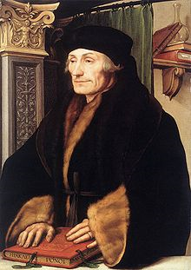
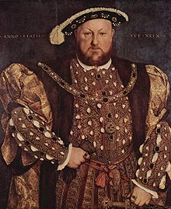
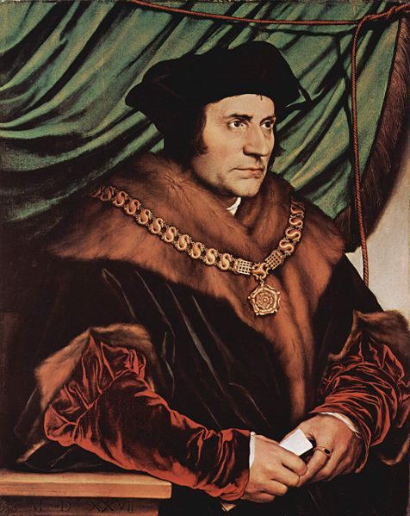
Hans Holbein ml.
Thomas More
http://upload.wikimedia.org/wikipedia/commons/thumb/3/30/Holbein-erasmus.jpg/423px-Holbein-erasmus.jpg
Portrét Erasma Rottredamského
http://upload.wikimedia.org/wikipedia/commons/thumb/8/8a/Hans_Holbein_d._J._074.jpg/490px-Hans_Holbein_d._J._074.jpg
Jindřich VIII.
http://upload.wikimedia.org/wikipedia/commons/thumb/f/f0/Hans_Holbein_d._J._065.jpg/476px-Hans_Holbein_d._J._065.jpg

Slide 19
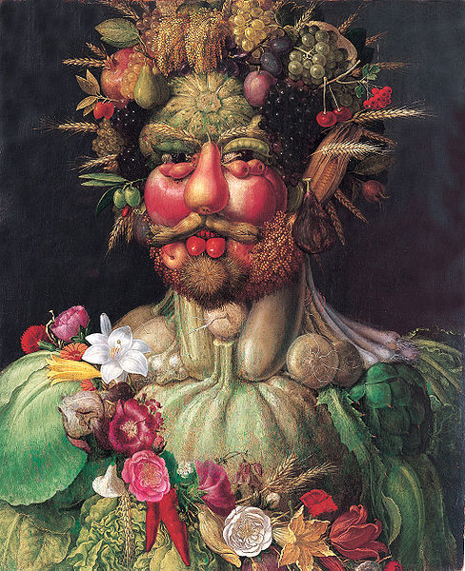
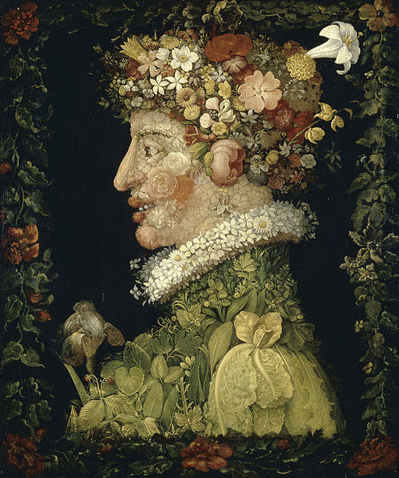
Arcimboldo
Jaro
http://upload.wikimedia.org/wikipedia/commons/thumb/d/d2/Arcimboldovertemnus.jpeg/488px-Arcimboldovertemnus.jpeg
Rudolf II.
http://upload.wikimedia.org/wikipedia/commons/a/a5/Giuseppe_Arcimboldo_-_Spring%2C_1573.jpg

Slide 20
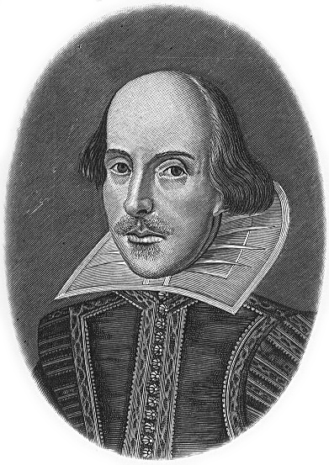


Literatura Shakespeare, Boccaccio, Dante Alighieri
http://upload.wikimedia.org/wikipedia/commons/2/2a/Hw-shakespeare.png
http://upload.wikimedia.org/wikipedia/commons/6/6f/Portrait_de_Dante.jpg
Portrét od Sandra Botticelliho
http://upload.wikimedia.org/wikipedia/commons/2/26/Giovanni_Boccaccio_01.jpg

Slide 21
ZDROJE
http://upload.wikimedia.org/wikipedia/commons/e/ec/Mona_Lisa%2C_by_Leonardo_da_Vinci%2C_from_C2RMF_retouched.jpg
http://upload.wikimedia.org/wikipedia/commons/a/af/Darnley_stage_3.jpg
http://upload.wikimedia.org/wikipedia/commons/thumb/6/68/Raffael_058.jpg/800px-Raffael_058.jpg
http://upload.wikimedia.org/wikipedia/commons/thumb/6/63/Michelangelos_David.jpg/450px-Michelangelos_David.jpg, CC BY-SA, autor: David Gaya
http://upload.wikimedia.org/wikipedia/commons/thumb/2/2d/Pra%C5%BEsk%C3%BD_hrad%2C_Letohr%C3%A1dek_kr%C3%A1lovny_Anny_02.jpg/800px-Pra%C5%BEsk%C3%BD_hrad%2C_Letohr%C3%A1dek_kr%C3%A1lovny_Anny_02.jpg, CC BY-SA, autor: Karen Blaha
http://upload.wikimedia.org/wikipedia/commons/thumb/4/40/Telc109.jpg/799px-Telc109.jpg, CC BY-SA, autor: Hans Weingartz
http://upload.wikimedia.org/wikipedia/commons/a/a0/Buchdrucker-1568.png
http://upload.wikimedia.org/wikipedia/commons/a/af/Buchdruck-15-jahrhundert_1.jpg
http://upload.wikimedia.org/wikipedia/commons/3/33/Gutenberg.jpg
http://upload.wikimedia.org/wikipedia/commons/f/f2/Nikolaus_Kopernikus.jpg
http://upload.wikimedia.org/wikipedia/commons/5/57/Heliocentric.jpg
http://upload.wikimedia.org/wikipedia/commons/thumb/d/d4/Johannes_Kepler_1610.jpg/436px-Johannes_Kepler_1610.jpg
http://upload.wikimedia.org/wikipedia/commons/1/19/Kepler-solar-system-1.png
http://upload.wikimedia.org/wikipedia/commons/2/2b/Tycho_Brahe.JPG
http://upload.wikimedia.org/wikipedia/commons/thumb/a/a6/Tychonian_system.svg/576px-Tychonian_system.svg.png
http://upload.wikimedia.org/wikipedia/commons/thumb/6/6e/Galileo_by_Passignano.jpg/482px-Galileo_by_Passignano.jpg
http://upload.wikimedia.org/wikipedia/commons/8/88/Galileo_facing_the_Roman_Inquisition.jpg
http://upload.wikimedia.org/wikipedia/commons/b/ba/Relief_Bruno_Campo_dei_Fiori_n1.jpg
http://upload.wikimedia.org/wikipedia/commons/1/15/Giordano_Bruno.jpg
http://upload.wikimedia.org/wikipedia/commons/2/27/Santi_di_Tito_-_Niccolo_Machiavelli%27s_portrait_headcrop.jpg
http://upload.wikimedia.org/wikipedia/commons/thumb/3/30/Holbein-erasmus.jpg/423px-Holbein-erasmus.jpg
http://upload.wikimedia.org/wikipedia/commons/c/ce/Johan_amos_comenius_1592-1671.jpg
http://upload.wikimedia.org/wikipedia/commons/9/90/Breznice_PB_CZ_chateau_sgraffito_detail_605.jpg
http://upload.wikimedia.org/wikipedia/commons/thumb/1/15/Petersdom_von_Engelsburg_gesehen.jpg/800px-Petersdom_von_Engelsburg_gesehen.jpg
http://upload.wikimedia.org/wikipedia/commons/thumb/4/40/Telc109.jpg/799px-Telc109.jpg, CC BY_SA, autor: Hans Weingartz
upload.wikimedia.org/wikipedia/commons/8/86/The_D%C4%85bski_Palace1.JPG
http://upload.wikimedia.org/wikipedia/commons/thumb/0/01/Cervena_Lhota%2C_Czech_Republic.jpg/800px-Cervena_Lhota%2C_Czech_Republic.jpg, CC BY-SA, autor Zdeněk Svoboda
http://upload.wikimedia.org/wikipedia/commons/a/a2/GT056-Antigua_SchlKids.jpeg
http://upload.wikimedia.org/wikipedia/commons/thumb/c/cc/Rucellai.jpg/465px-Rucellai.jpg

Slide 22
http://upload.wikimedia.org/wikipedia/commons/thumb/2/2d/Pra%C5%BEsk%C3%BD_hrad%2C_Letohr%C3%A1dek_kr%C3%A1lovny_Anny_02.jpg/800px-Pra%C5%BEsk%C3%BD_hrad%2C_Letohr%C3%A1dek_kr%C3%A1lovny_Anny_02.jpg, CC BY-SA, autor: Karen Blaha
http://upload.wikimedia.org/wikipedia/commons/thumb/6/6a/Schwarzenbersk%C3%BD_pal%C3%A1c_1.JPG/200px-Schwarzenbersk%C3%BD_pal%C3%A1c_1.JPG,CC BY-SA, autor: VitVit
http://upload.wikimedia.org/wikipedia/commons/thumb/a/af/St_George_Donatello_Orsanmichele_n1.jpg/239px-St_George_Donatello_Orsanmichele_n1.jpg
http://upload.wikimedia.org/wikipedia/commons/thumb/f/f0/Donatello_-_David_-_Floren%C3%A7a.jpg/372px-Donatello_-_David_-_Floren%C3%A7a.jpg, CC BY-SA, autor: Patrick A.Rodgers
http://upload.wikimedia.org/wikipedia/commons/thumb/0/0b/Sandro_Botticelli_-_La_nascita_di_Venere_-_Google_Art_Project_-_edited.jpg/800px-Sandro_Botticelli_-_La_nascita_di_Venere_-_Google_Art_Project_-_edited.jpg
http://upload.wikimedia.org/wikipedia/commons/thumb/0/08/Leonardo_da_Vinci_%281452-1519%29_-_The_Last_Supper_%281495-1498%29.jpg/800px-Leonardo_da_Vinci_%281452-1519%29_-_The_Last_Supper_%281495-1498%29.jpg
http://upload.wikimedia.org/wikipedia/commons/thumb/2/22/Da_Vinci_Vitruve_Luc_Viatour.jpg/441px-Da_Vinci_Vitruve_Luc_Viatour.jpg
http://upload.wikimedia.org/wikipedia/commons/thumb/5/57/Lady_with_an_Ermine.jpg/439px-Lady_with_an_Ermine.jpg
http://upload.wikimedia.org/wikipedia/commons/thumb/6/6a/Mona_Lisa.jpg/396px-Mona_Lisa.jpg
http://upload.wikimedia.org/wikipedia/commons/thumb/e/ea/Raffael_051.jpg/440px-Raffael_051.jpg
http://upload.wikimedia.org/wikipedia/commons/thumb/9/94/Sanzio_01.jpg/773px-Sanzio_01.jpg
upload.wikimedia.org/wikipedia/commons/thumb/9/94/Sanzio_00.jpg/444px-Sanzio_00.jpg
http://upload.wikimedia.org/wikipedia/commons/thumb/8/88/San_Pietro_in_Vincoli_Rome_2011_14.jpg/388px-San_Pietro_in_Vincoli_Rome_2011_14.jpg
http://upload.wikimedia.org/wikipedia/commons/thumb/1/1f/Michelangelo%27s_Pieta_5450_cropncleaned_edit.jpg/572px-Michelangelo%27s_Pieta_5450_cropncleaned_edit.jpg, CC BY-SA, autor: Stanislav Traykov
http://upload.wikimedia.org/wikipedia/commons/thumb/6/63/Michelangelos_David.jpg/450px-Michelangelos_David.jpg, CC BY-SA, autor: David Gaya
http://upload.wikimedia.org/wikipedia/commons/thumb/2/24/Rome_Sistine_Chapel_01.jpg/456px-Rome_Sistine_Chapel_01.jpg
http://upload.wikimedia.org/wikipedia/commons/d/db/Lightmatter_Sistine_Chapel_ceiling.jpg, CC BY-SA, autor: Aaron Logan
http://upload.wikimedia.org/wikipedia/commons/thumb/8/88/Albrecht_D%C3%BCrer%2C_Selbstbildnis_mit_26_Jahren_%28Prado%2C_Madrid%29.jpg/456px-Albrecht_D%C3%BCrer%2C_Selbstbildnis_mit_26_Jahren_%28Prado%2C_Madrid%29.jpg
http://upload.wikimedia.org/wikipedia/commons/thumb/7/70/Albrecht_D%C3%BCrer_099.jpg/714px-Albrecht_D%C3%BCrer_099.jpg
http://upload.wikimedia.org/wikipedia/commons/thumb/3/30/Holbein-erasmus.jpg/423px-Holbein-erasmus.jpg
http://upload.wikimedia.org/wikipedia/commons/thumb/8/8a/Hans_Holbein_d._J._074.jpg/490px-Hans_Holbein_d._J._074.jpg
http://upload.wikimedia.org/wikipedia/commons/thumb/f/f0/Hans_Holbein_d._J._065.jpg/476px-Hans_Holbein_d._J._065.jpg
http://upload.wikimedia.org/wikipedia/commons/thumb/d/d2/Arcimboldovertemnus.jpeg/488px-Arcimboldovertemnus.jpeg
http://upload.wikimedia.org/wikipedia/commons/a/a5/Giuseppe_Arcimboldo_-_Spring%2C_1573.jpg
http://upload.wikimedia.org/wikipedia/commons/2/2a/Hw-shakespeare.png
http://upload.wikimedia.org/wikipedia/commons/2/26/Giovanni_Boccaccio_01.jpg
http://upload.wikimedia.org/wikipedia/commons/6/6f/Portrait_de_Dante.jpg

